Slide 1
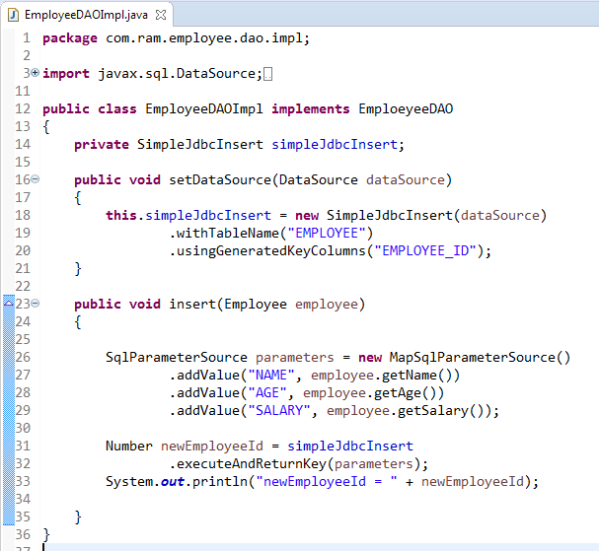
Using SqlParameterSource to provide parameter values
MapSqlParameterSource that resembles a Map but provides a more convenient addValue method that can be chained.

